Slide 1
Mitigation Strategies
Lesson 5 Activity 1

Slide 2
An imbalance in Processes
Biomass
organic carbon
Atmosphere
Inorganic CO₂
Before the industrial revolution, the carbon in the atmosphere pool maintained a balance between the biomass pool through photosynthesis and cellular respiration.
As carbon concentrations in the atmosphere continue to rise, so will the global temperatures. What are the results of increasing temperatures for people and the planet?
However, the biomass pool can only sequester a limited amount of carbon. Today, we are adding too much carbon to the atmosphere pool. This causes an imbalance.
Soil
organic carbon
Fossil Fuels
organic carbon
If we continue to use fossil fuels at the rates we are using them now, it will be impossible for the planet to maintain the natural balance between the atmosphere and biomass pool.
When we burn fossil fuels in cars and buildings, we move carbon from the fossil fuel pool to the atmosphere pool.
Notes:
Use this slide to show that as we move carbon from the fossil fuel pool to the atmosphere pool, the atmosphere gets bigger. The biomass pool can only sequester a limited amount of carbon. This means that the carbon in the atmosphere will continue to grow over time, leading to global warming.

Slide 3
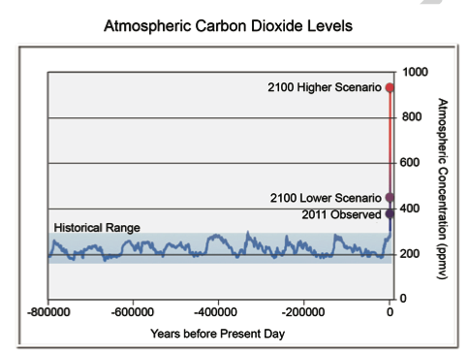
This is a Chart that shows 2 future scenarios of Carbon emissions about 85 years from now. The purple dot shows the concentration if we reduce carbon emissions by a lot. The red dot shows what will happen if we don’t reduce carbon emissions. What can we do to try to keep carbon concentration low in the future?
Notes:
This graph comes from the 2013 Draft National Climate Assessment. You can read the entire report here: http://www.globalchange.gov/what-we-do/assessment

Slide 4
Individual Actions
Societal Actions
Write suggestions here
Write suggestions here

